Slide 1







Learning Pulse
2026 PEAAII AI APPLICATIONS HACKATHON · UMASS BOSTON
A little insight. A better next step.
Connecting AI-assisted student learning with the evidence teachers need to make better instructional decisions.
TEAM 3
Peter
Bucci
Ashriya
Tuladhar
Anya
Tongprasith
Drashti
Patel
Haniya
Adil
Swikritee
Chuke
Notes:
[0:00–0:20 · 20 seconds] Good afternoon. We’re Team 3: Peter, Ashriya, Anya, Drashti, Haniya and Swikritee, students here at UMass Boston. Our project is Learning Pulse. Our tagline is “a little insight, a better next step.” Learning Pulse connects AI-assisted student learning with the evidence teachers need to make better instructional decisions.

Slide 2

Sam’s confusion stays hidden until the exam
THE PROBLEM
IN LECTURE
AT HOME
ON THE EXAM
Knows the vocabulary
Mixes up two ideas
Too late to help
Sam follows along and feels confident.
Transmission delay and propagation delay blur together, and Sam doesn’t notice.
The professor sees a wrong answer and a grade, not the reasoning behind it.
“Students need help when confusion happens. Teachers need to see that confusion before it becomes a grade.”
02
Notes:
[0:20–1:00 · 40 seconds] Picture Sam, a student in an intro networking course. In lecture, Sam knows the vocabulary and feels confident. At home, Sam quietly mixes up two ideas, transmission delay and propagation delay, without noticing. The confusion only shows up on the exam, and by then the professor sees just a wrong answer and a grade. That grade doesn’t say what Sam misunderstood, whether Sam got help, or whether half the class had the same problem. Students need help when confusion happens. Teachers need to see it before it becomes a grade. (Note, not spoken: Sam is an illustrative student, not a real user.)

Slide 3
Today’s tools each see part of the picture
THE LANDSCAPE
DIRECT
DIRECT
INDIRECT
INDIRECT
AI tutors
Practice and assessment
Learning management
General AI chatbots
Khanmigo
Wayground (formerly Quizizz), Kahoot
Canvas, Blackboard, Google Classroom
Any general-purpose assistant
Guided tutoring, lesson planning and summaries of student work
Engaging practice, quizzes and performance reports
Course materials, coursework, grades and analytics
Quick explanations, not tied to the course’s approved material
OUR FOCUS
Student reasoning → evidence → teacher review → approved follow-up → new work
03
Notes:
[1:00–1:30 · 30 seconds] Good tools already exist. Directly, Khanmigo offers AI tutoring and teacher support, and Wayground and Kahoot offer practice with reporting. Indirectly, Canvas, Blackboard and Google Classroom run the course, and students can always ask a general chatbot. We’re not claiming these tools lack AI or analytics. Our focus is narrower: one course-specific loop, from a student’s reasoning, to evidence, to the teacher’s review, to an approved follow-up, and back to new work.

Slide 4
We start where concepts are hardest
WHO WE SERVE
PRIMARY
University instructors
SCALE CONTEXT
Spot misunderstandings early and spend class time where it matters.
16.2M
SECONDARY
Undergraduate students
Guided explanations, questions and feedback outside class.
U.S. undergraduate enrollments
in fall 2025
POTENTIAL ADOPTERS
Departments and universities
Including teaching and learning centers.
Source: National Student Clearinghouse Research Center, January 2026.
Networking: our first lesson
Computer science
Engineering
Mathematics
Physics
04
Notes:
[1:30–1:55 · 25 seconds] Our primary users are university instructors who want to catch misunderstandings early. Students like Sam get guided help outside class, and departments and teaching centers could adopt it more broadly. We’re starting with concept-heavy intro courses, beginning with a networking lesson here at UMass Boston. For scale, about 16.2 million undergraduates enrolled in the U.S. last fall. That’s context, not a market claim.

Slide 5



Learning Pulse connects both sides of learning
HOW IT WORKS
STEP 1 · TEACHER
STEP 2 · STUDENT
STEP 3 · TEACHER
Prepares
lesson
Learns
evidence
Investigates
AI proposes material; the teacher approves it.
Every answer and every hint shown is recorded.
Reviews the evidence and approves a follow-up.
The approved follow-up becomes new student work
05
Notes:
[1:55–2:25 · 30 seconds] Here’s the whole idea on one slide. First, the teacher prepares a lesson. AI can propose material, but the teacher approves it. Second, the student works through it with an AI tutor, and the system records what the student actually wrote and what help they actually saw. Third, the teacher investigates that evidence and approves a targeted follow-up, which becomes new student work. Then the loop continues. Let’s follow Sam through each step.

Slide 6
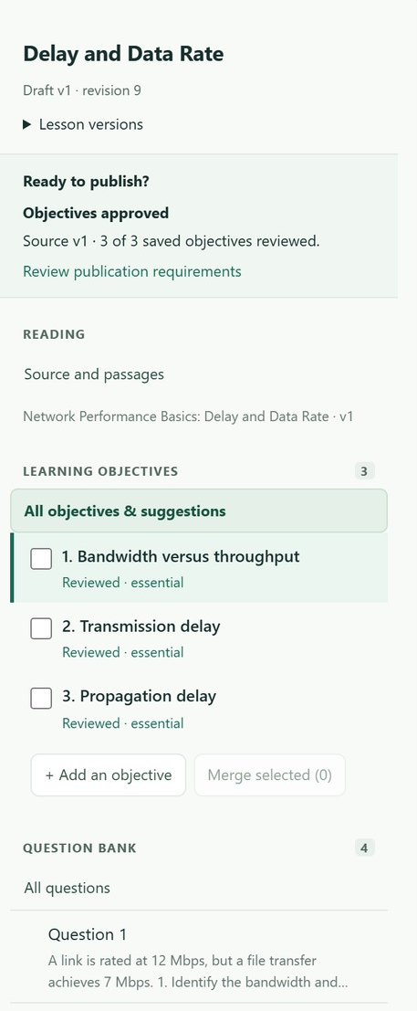
The teacher sets the source of truth
STEP 1 · TEACHER PREPARES
AI proposes. The teacher approves.
1
Bring in course material
Learning Pulse organizes it into citable source passages.
2
Review what AI suggests
Proposed learning objectives and questions, all editable.
3
Publish a fixed lesson version
Students get the approved lesson, and every answer stays tied to it.
06
Notes:
[2:25–2:50 · 25 seconds] Step one is the teacher. An instructor brings in course material; for our demo, an openly licensed networking textbook section. Learning Pulse organizes it into source passages, and AI can propose objectives and questions. The teacher edits them and publishes a fixed lesson version. AI proposes; the teacher approves. And as you see on the right, every answer stays tied to that exact version and passage.

Slide 7
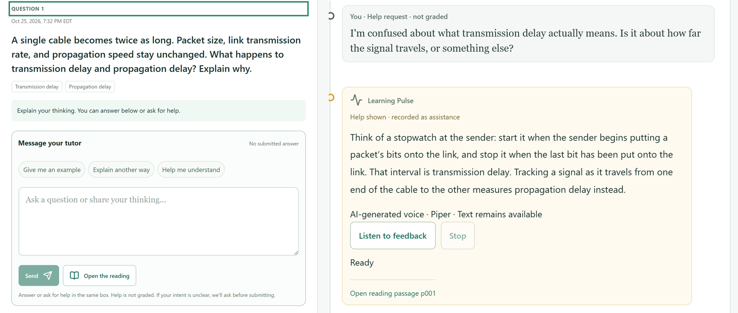
Sam works through the question with a tutor
STEP 2 · STUDENT LEARNS
Ask or answer
The tutor tells a help request from an answer, and asks if it’s unclear.
Hints, not answers
It separates the two ideas and points Sam back to the reading.
Everything is saved
Sam’s own words and the help actually shown.
07
Notes:
[2:50–3:30 · 40 seconds] Step two: Sam opens the assignment. If a cable becomes twice as long, what happens to transmission and propagation delay? Sam can answer or ask for help in the same box. The system tells a help request from an answer, and if it’s unclear, it asks before grading. Here, Sam asks for help. Instead of giving the answer away, the tutor separates the two ideas and points Sam back to the assigned reading. Learning Pulse records what Sam wrote and what help was actually shown. These screens are from our test environment.

Slide 8



Inside the tutor: propose, check, act, record
UNDER THE HOOD · AGENTIC WORKFLOW
01
02
03
04
05
Student input
AI proposes
Server checks
Tool runs
Result recorded
A question, an answer or a request for help
The tutor picks an instructional action
Access, lesson version and source are validated
Only an authorized tool executes
Saved as evidence with its source
The tutor observes each result and chooses its next step
AUTHORIZED TOOLS
Content retrieval
Tutoring
Evaluation
Evidence recording
Intervention drafts
08
Notes:
[3:30–4:15 · 45 seconds] For the technical judges, here’s the agentic part in plain terms. When Sam sends a message, the AI doesn’t act on its own. It proposes an instructional action, like retrieving a passage or evaluating an answer. Our server checks that proposal: is this student allowed, is this the right lesson version, is the source approved? Only then does an authorized tool run. The result is recorded as evidence, and the tutor observes it to choose the next step. So it’s one tutor with a bounded set of tools, not a team of autonomous agents, with structured outputs and Zod schemas validating each step.

Slide 9
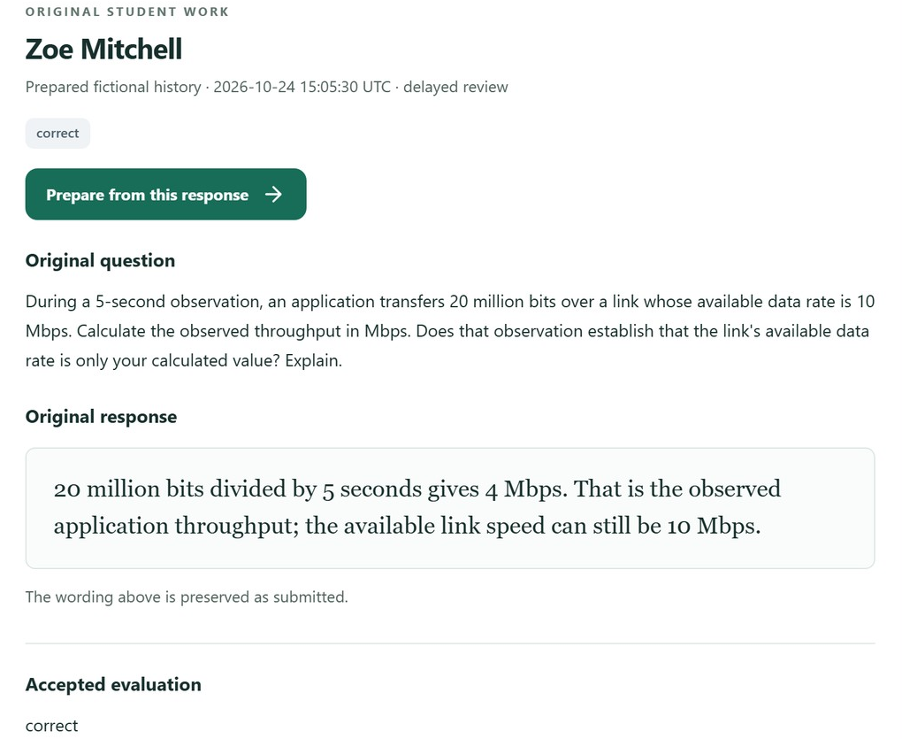
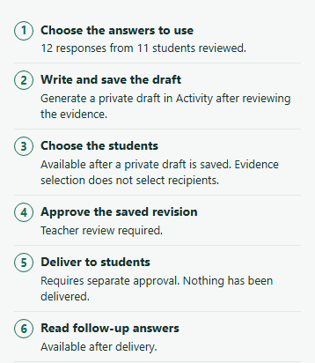
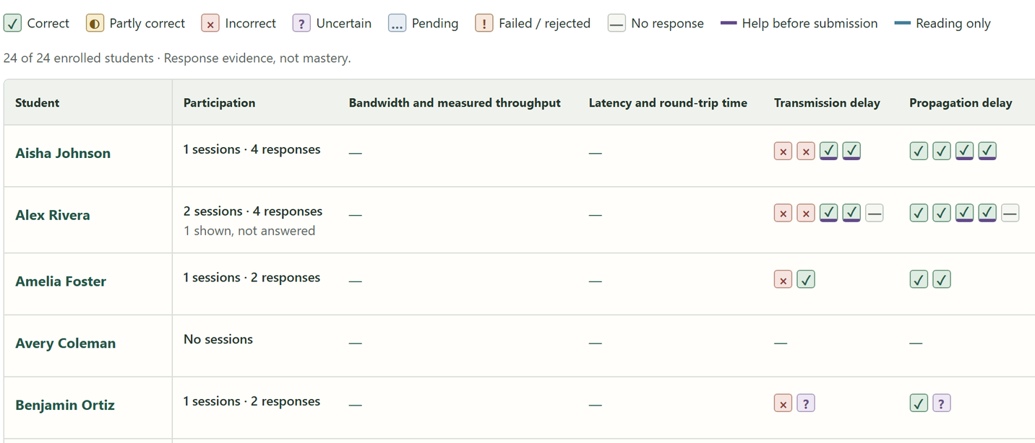
The professor sees how students reasoned
STEP 3 · TEACHER INVESTIGATES AND RESPONDS
1 See the class
2 Read the reasoning
3 Prepare a follow-up
Every student’s attempts on every idea, including answers given after help.
The original words, preserved as submitted, with the accepted evaluation.
AI helps draft practice. Students see it only after the teacher approves.
09
Notes:
[4:15–4:55 · 40 seconds] Step three: the professor. Instead of one percentage, the class grid shows every student’s attempts on each idea, and flags answers given after help. Here, one fictional student has a long run of mixed attempts on transmission delay, the kind of pattern Sam would leave. Select a cell to read the student’s original words and the accepted evaluation. Uncertain evidence isn’t treated as wrong, and a possible misconception isn’t presented as fact. From any response, the professor can prepare a follow-up, and as these steps show, nothing reaches students until the professor approves it.

Slide 10
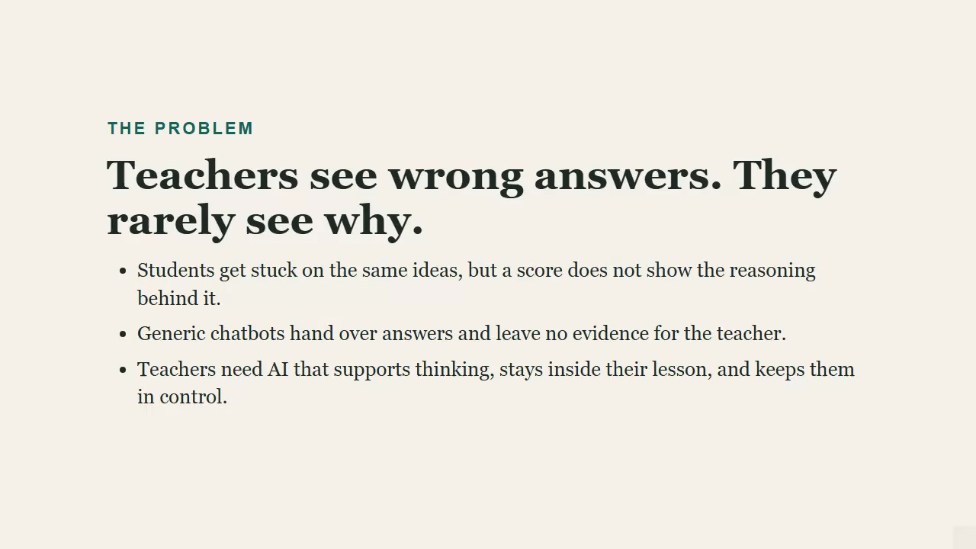
See it in action
PRODUCT DEMO
0:17
The teacher builds and approves the lesson
1:17
Two students take different paths with the tutor
2:40
The teacher reads the evidence
10
Notes:
[Click the video to start. It runs 3:27 with no sound, so narrate over it.] [0:00] Teachers can see that a student got an answer wrong. What they rarely see is why. A score doesn’t show the reasoning. A generic chatbot just hands over the answer and leaves no evidence behind. Teachers need AI that helps students think, stays inside their lesson, and keeps the teacher in control. [0:09] That’s what gave us the idea for Learning Pulse. The teacher builds a lesson from their own reading and approves it. An AI tutor proposes a teaching action, and the server checks that action before anything runs. And everything the student wrote, and every bit of help they were shown, goes back to the teacher as evidence. [0:17] Here’s the teacher’s workspace. The overview shows where students are struggling. Insights group possible reasoning concerns, with supporting and contrary evidence, so one wrong answer is never treated as a diagnosis. [0:33] To make a lesson, the teacher starts from their own reading and writes learning objectives tied to exact passages. The AI then drafts questions, and a second, independent AI pass reviews them. But the teacher reviews every question before anything is approved. [0:57] The teacher also reviews what the tutor is allowed to do. Then they publish an immutable lesson version and activate it for the class. [1:17] Now on the student’s side, students use one conversation box. They can ask for help or submit an answer. Help is never graded, and if the tutor can’t tell which one a student means, it asks first. These next scenes are real sessions from earlier today, using live model calls. [1:23] This is Alex. He’s working on how packet size and cable length affect delay. He asks for help, and the AI proposes an explanation. The server validates that action, and the help is recorded as assistance. Then Alex answers, and his answer contains a misconception: he thinks a longer cable increases transmission delay. [1:57] Because Alex’s answer showed a misconception, the AI generated a new diagnostic question, grounded in the teacher’s reading. Alex answers it correctly. Since he had already been shown help, the record marks that as help-assisted, not independent. [2:17] Here’s what the model actually decided. A help question led to an explanation. A wrong answer led to a new diagnostic question. A correct answer led to moving on. The AI proposes, and the application validates and executes. [2:28] Jordan answered the first question correctly on his own, and no extra help is needed. Different student, different decision. [2:40] Back to the teacher. The roster shows Alex’s path next to Jordan’s, with help shown and independent work marked separately. Opening Alex, the teacher sees his original answers, the evaluations, the help he was shown, and the uncertainty. [3:11] From this evidence, the teacher can prepare a follow-up activity. (The video shows the empty Draft with AI screen, so don’t say a draft was generated.) [3:17] A score tells a teacher what happened. It doesn’t tell them why. Learning Pulse helps close that gap. It shows how students are thinking, where they’re struggling, and what support they’ve received. Because the goal isn’t to replace teachers with AI. It’s to give teachers the insight they need to help every student learn.

Slide 11
From answering questions to improving instruction
WHAT MAKES IT DIFFERENT
1
2
3
Reasoning, not just correctness
Grounded in approved material
AI closes the loop, people decide
Original answers, the help received and evaluations stay together, so professors can see what happened.
The tutor works from the instructor’s lesson version, and old work keeps its original source.
Student work informs teaching, and instructors approve every official instructional action.
11
Notes:
[4:55–5:25 · 30 seconds] So what sets Learning Pulse apart? First, we capture reasoning, not just correctness: answers, help received and evaluations stay together. Second, learning stays grounded in instructor-approved material, and old work keeps its original source. Third, AI helps close the loop, but people decide: instructors approve every official action. These describe our focus, not claims that other tools can’t do any of this.

Slide 12
Responsible by design, honest about limits
RESPONSIBLE AI
Safeguards we built
How we tested it
Not yet shown
The server checks every AI action before it runs.
Deterministic unit and TypeScript tests
Measured improvement in learning outcomes
Teachers approve interventions before students see them.
Signed-in browser workflows with fictional students
A production deployment and compliance review
Uncertain evidence is never scored as wrong.
Database persistence and save-recovery checks
Full accessibility and device testing
“AI supports instructional decisions. It doesn’t replace educator judgment.”
12
Notes:
[5:25–6:05 · 40 seconds] Because this is an agentic AI project, responsibility matters. Every AI action passes server checks before it runs. Teachers approve interventions before students see them, and uncertain evidence is never scored as wrong. We’ve tested this with unit tests, signed-in browser workflows using fictional students, and database and recovery checks. But those are engineering checks. We haven’t measured learning outcomes, this isn’t a production deployment, and accessibility and device testing are still in progress. Our principle: AI supports instructional decisions; it doesn’t replace educator judgment.

Slide 13
From one lesson to a whole course
FUTURE VISION
NEAR TERM
MEDIUM TERM
LONG TERM
Prove it in classrooms
Broaden and connect
A learning intelligence layer
Finish cross-role testing, validate the tutor with real models and pilot with instructors and students.
More subjects, richer learning histories, visual explanations and Canvas integration.
Help educators understand how students reason across an entire course.
13
Notes:
[6:05–6:30 · 25 seconds] Near term, we want to prove this in real classrooms: finish cross-role testing, validate the tutor with real models, and pilot with instructors and students. Then we’ll broaden to more subjects and connect with Canvas. Long term, Learning Pulse could become a learning intelligence layer for a whole course. Licensing is a possible model, but it isn’t validated yet.

Slide 14
Learning Pulse turns student reasoning into better-informed teaching decisions.
THANK YOU
Questions?
Notes:
[6:30–6:45 · 15 seconds] So the next time Sam mixes up two ideas, the professor can see it and help before it becomes a grade. Learning Pulse turns student reasoning into better-informed teaching decisions. Thank you. We’d love to take your questions.

Slide 15
References
APPENDIX
Learning Pulse repository
github.com/peterbucci/ai-teaching-platform
BUILT WITH
National Student Clearinghouse Research Center, Final Fall Enrollment Trends (January 2026)
Frontend · Next.js, React, TypeScript, Tailwind CSS
nscresearchcenter.org/final-fall-enrollment-trends
Canvas by Instructure
Backend and data · Next.js server endpoints, Node.js, PostgreSQL, Docker Compose, Better Auth
instructure.com/canvas
Khanmigo, Khan Academy
khanmigo.ai
AI and evaluation · OpenAI API, structured outputs, source-grounded retrieval, server-side action validation, Zod schemas
Wayground, Reports on Wayground
help.wayground.com/support/solutions/articles/158000404058
Peterson and Davie, Computer Networks: A Systems Approach, §1.5.1 “Bandwidth and Latency,” CC BY 4.0
Quality · GitHub Actions, TypeScript and deterministic tests, browser integration tests, authentication, data-integrity and recovery tests
github.com/SystemsApproach/book · creativecommons.org/licenses/by/4.0
14
Notes:
Appendix slide for reference during Q&A; not presented in the 7-minute talk.

